Slide 1
Sherzodbek`s Project Presentation XK1E0G

Slide 2

Importing data

Slide 3
Hypothesis 1
I assume that action movies are the most liked by audiences compared to other genres.
Tasks used: Graph

Slide 4
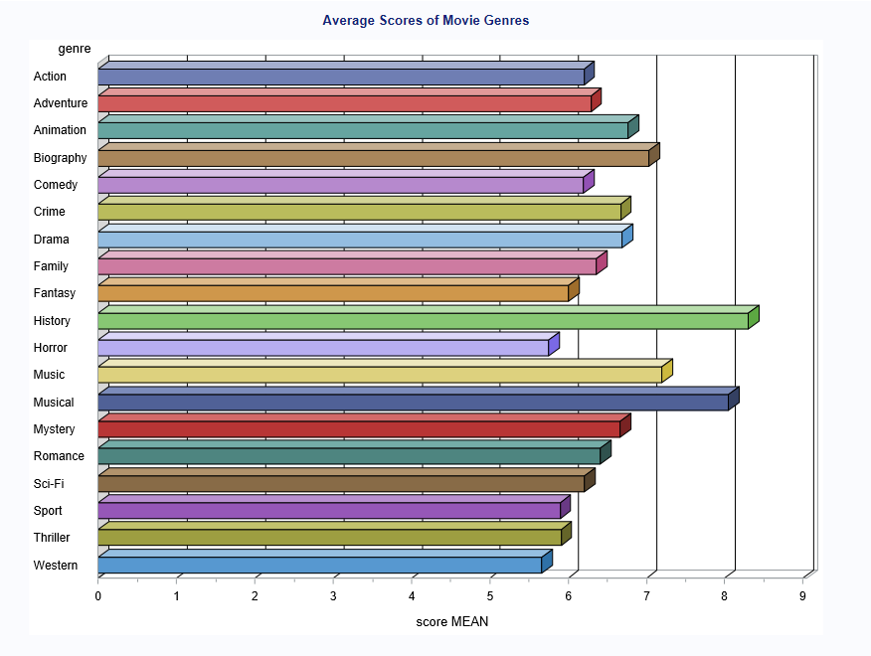
Hypothesis 1: Graph

Slide 5

Hypothesis 1: Steps

Slide 6

Hypothesis 1:Steps

Slide 7

Hypothesis 1: Steps

Slide 8
Hypothesis 2
I thought that comedy is the genre with the most G-rated movies across various countries and categories.
Tasks used: Query Builder(Filter), Graph(Pie Chart), Prompt

Slide 9
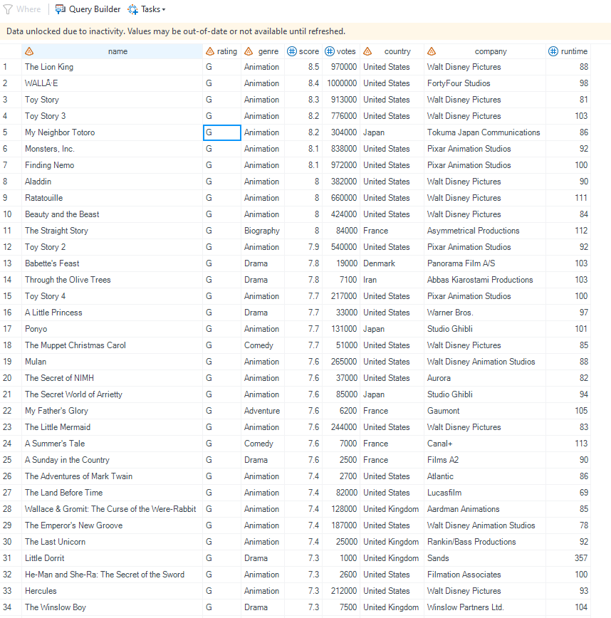
Hypothesis 2: Query

Slide 10
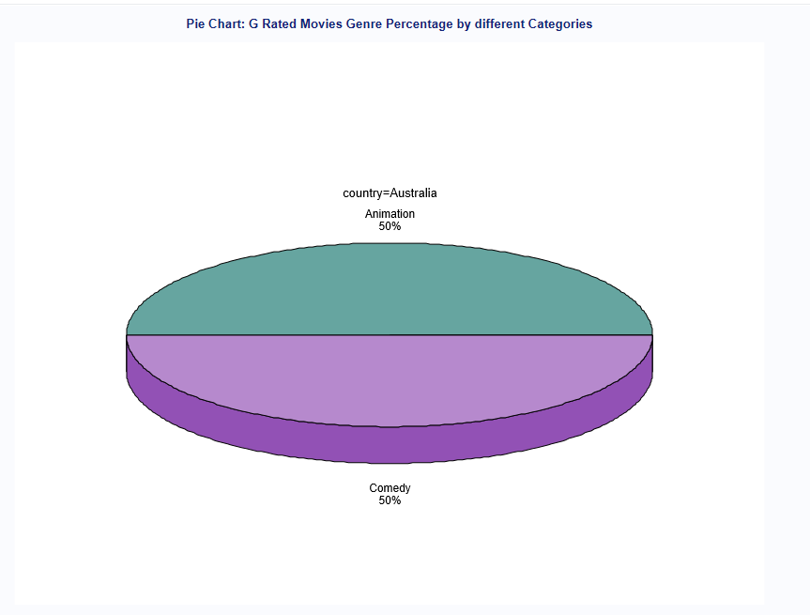
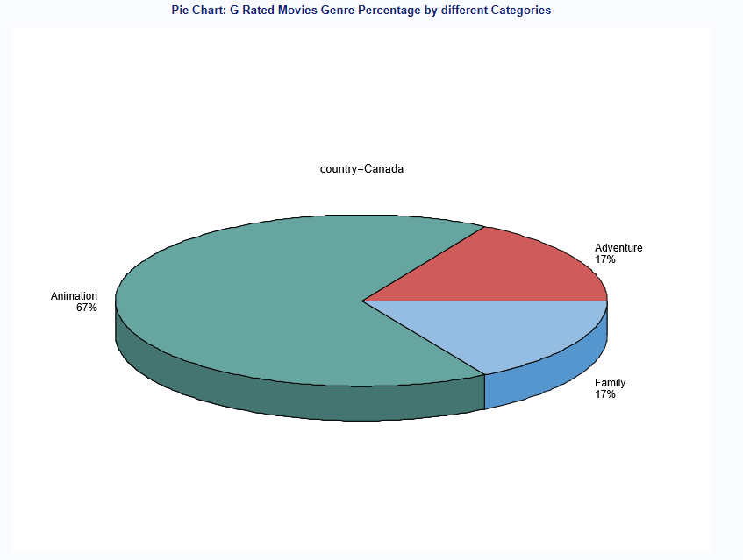
Hypothesis 2: Graph

Slide 11
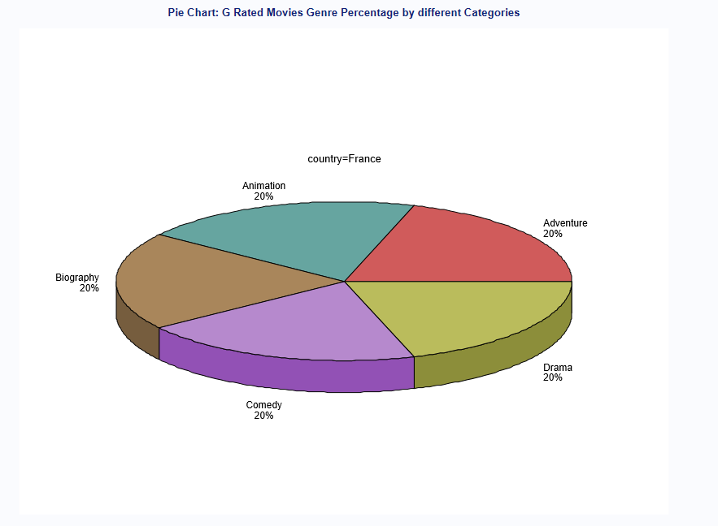
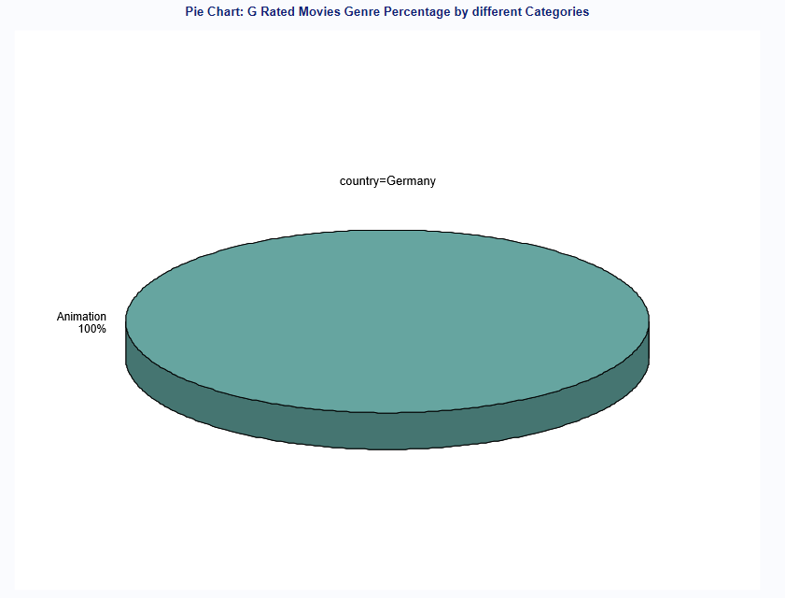
Hypothesis 2: Graph

Slide 12
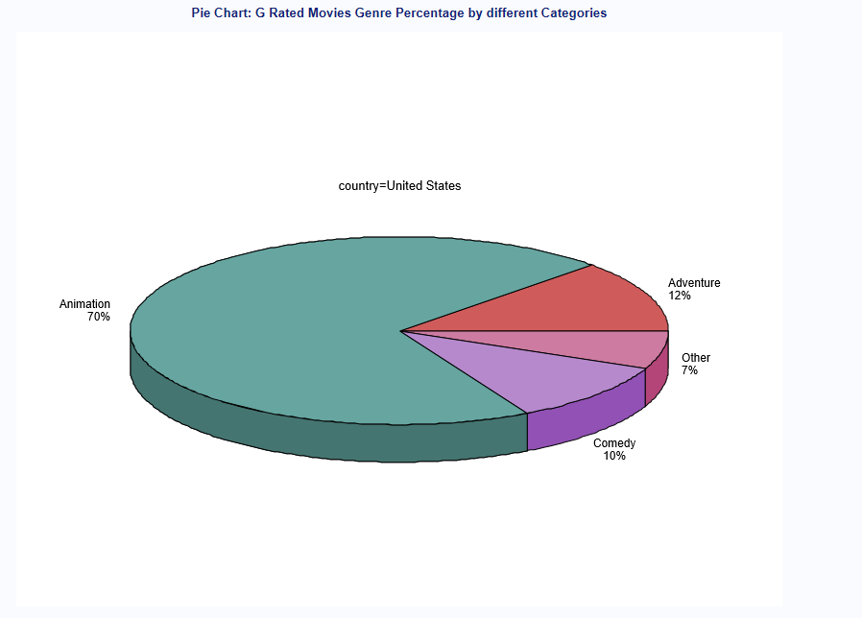
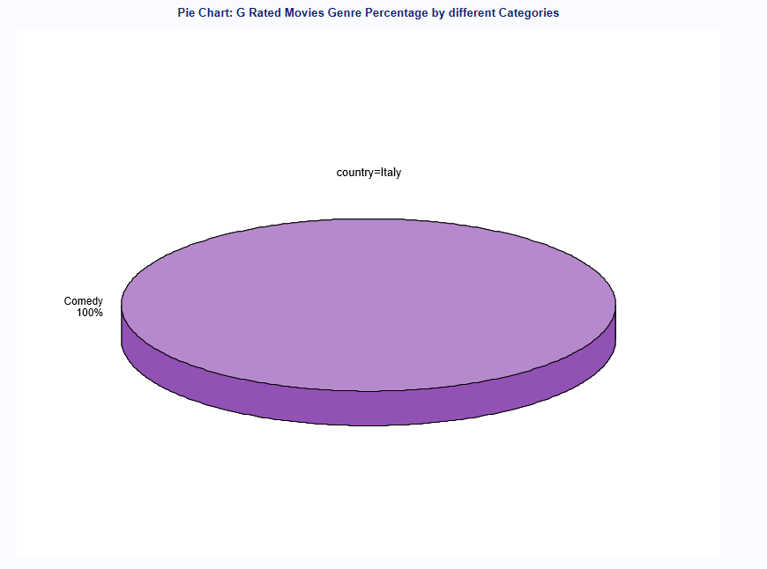
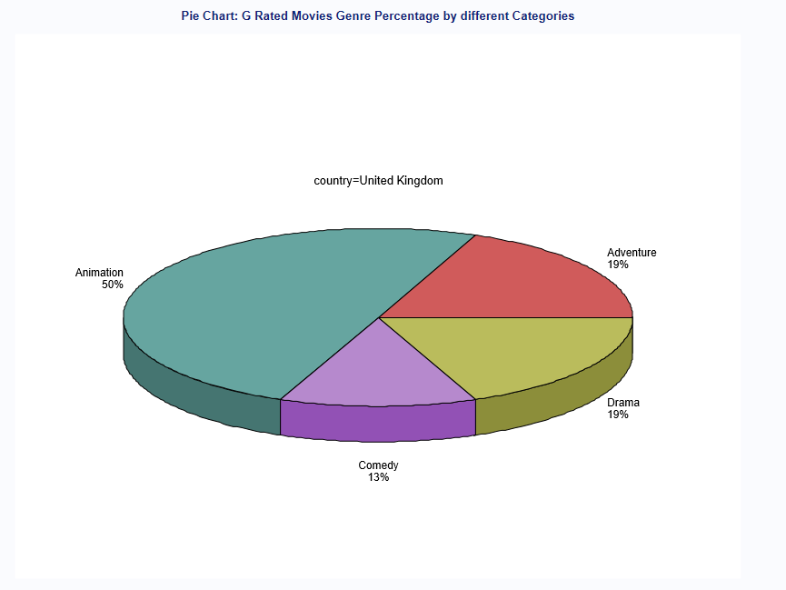
Hypothesis 2: Graph

Slide 13

Hypothesis 2: Steps

Slide 14

Hypothesis 2: Steps

Slide 15

Hypothesis 2: Steps

Slide 16
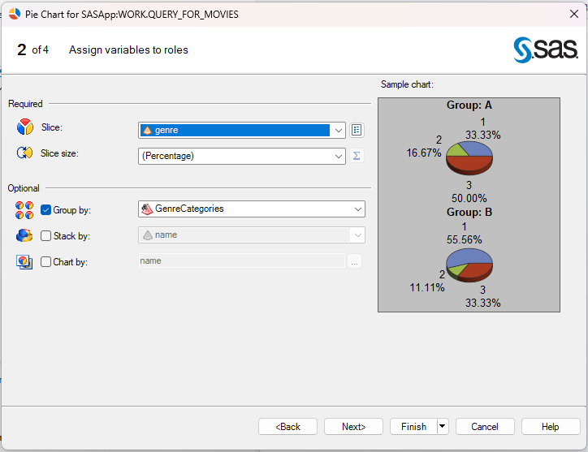
Hypothesis 2: Steps

Slide 17
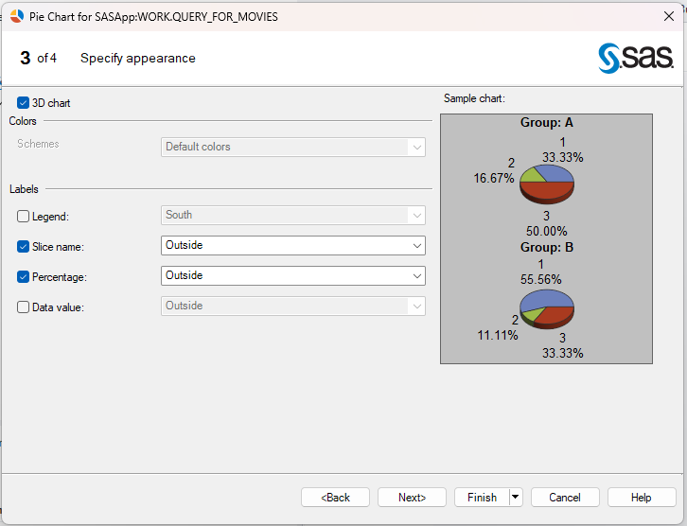
Hypothesis 2: Steps

Slide 18
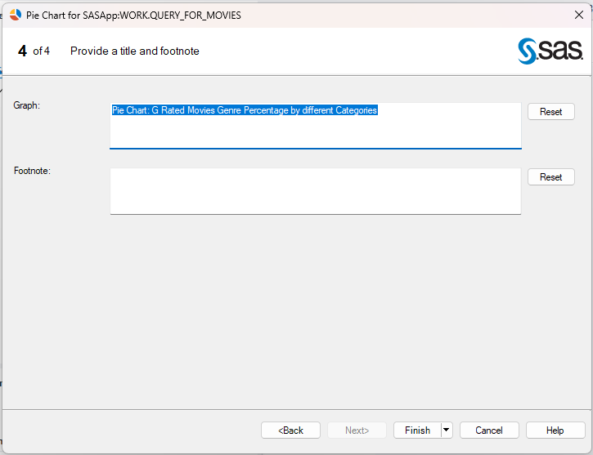
Hypothesis 2: Steps

Slide 19

Hypothesis 2: Steps

Slide 20

Hypothesis 2: Steps

Slide 21
Hypothesis 3
I assume that movies from the USA and the UK have the highest mean, minimum, and maximum scores compared to those from other countries.
Tasks used: Summary Statistics

Slide 22
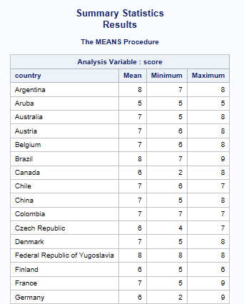
Hypothesis 3: Summary Stats

Slide 23
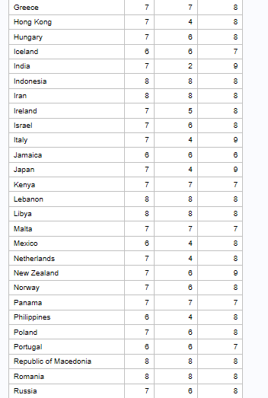
Hypothesis 3: Summary Stats

Slide 24
Hypothesis 3: Summary Stats

Slide 25
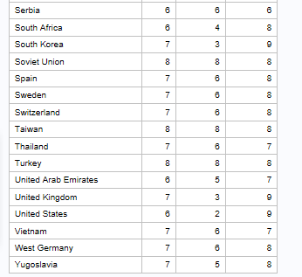
Hypothesis 3: Summary Stats

Slide 26
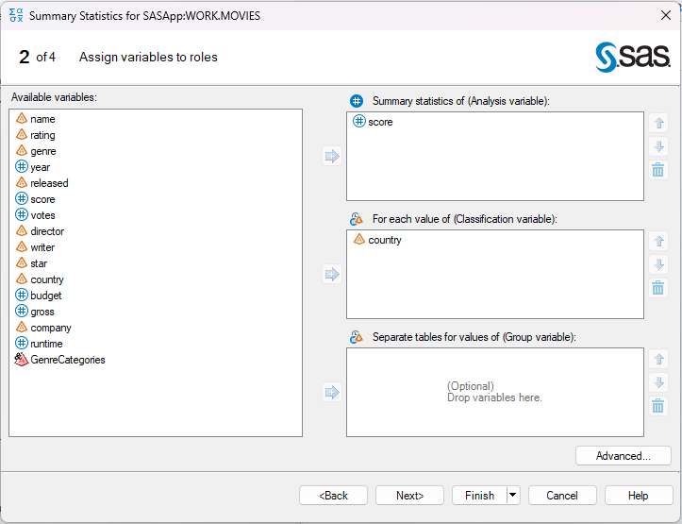
Hypothesis 3: Steps

Slide 27
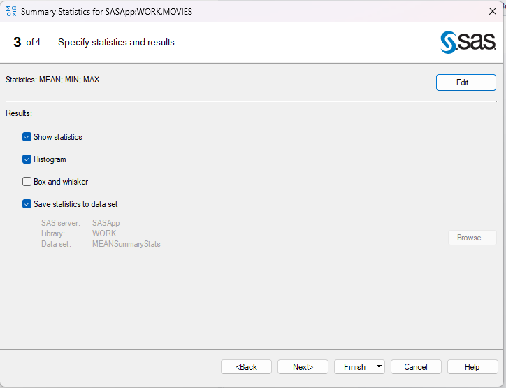
Hypothesis 3: Steps

Slide 28
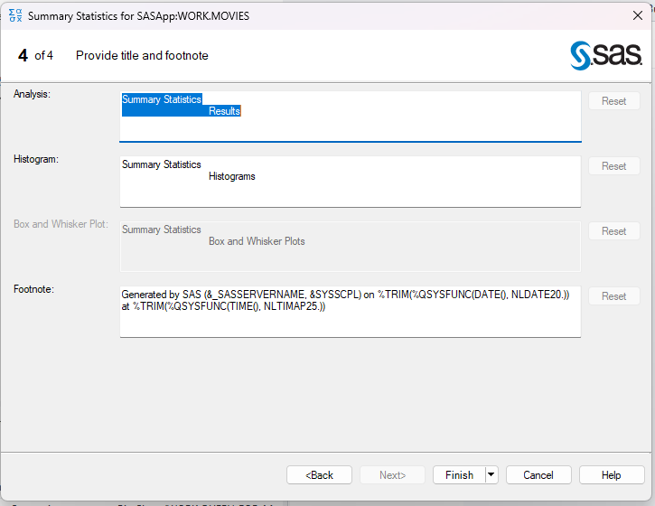
Hypothesis 3: Steps

Slide 29

Hypothesis 3: Steps

Slide 30
Hypothesis 4
I assume that action movies generate the highest box office revenue compared to other genres.
Tasks used: Computed Columns(Creating New Variable), Summary Report

Slide 31
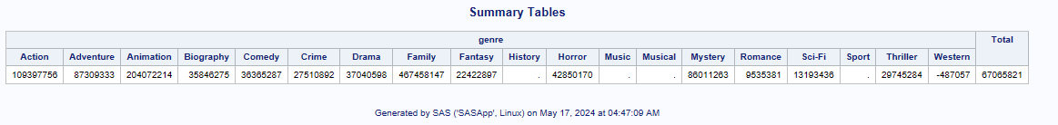
Hypothesis 4: Summary Report

Slide 32
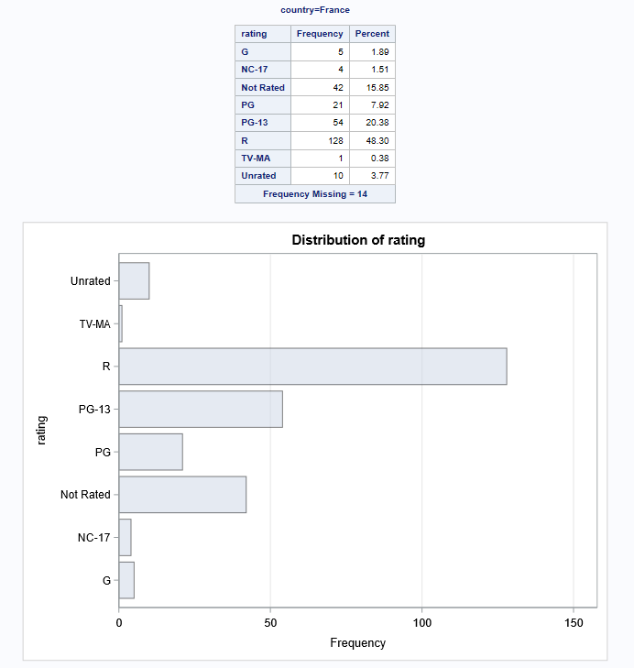
Hypothesis 4: Summary Report

Slide 33
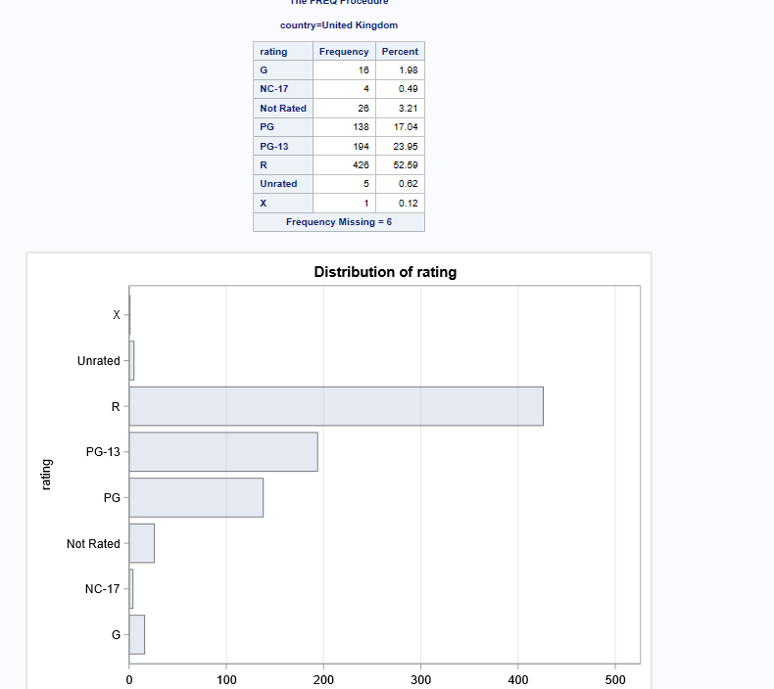
Hypothesis 4: Summary Report

Slide 34
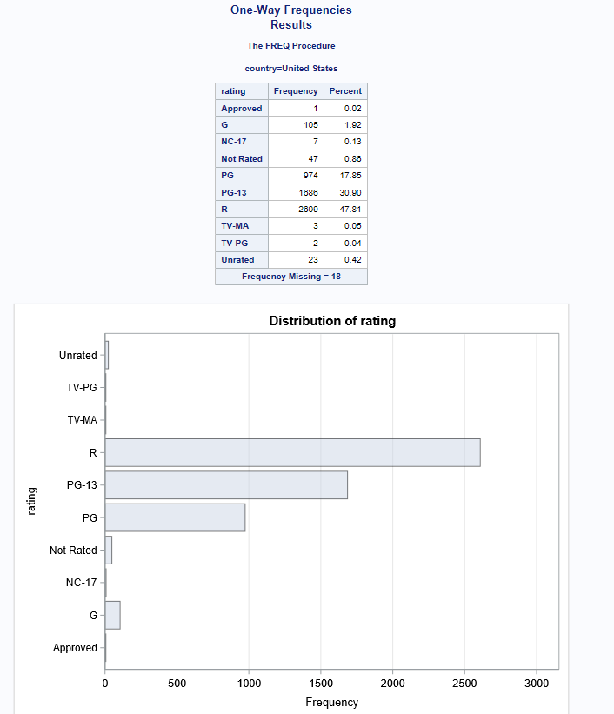
Hypothesis 4: Summary Report

Slide 35
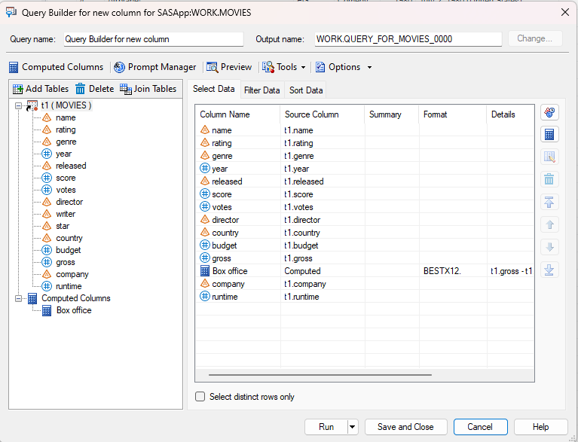
Hypothesis 4: Steps

Slide 36
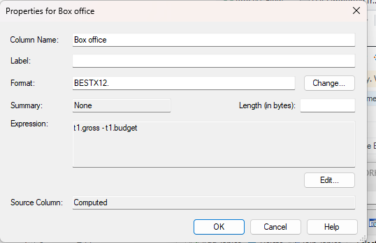
Hypothesis 4: Steps

Slide 37
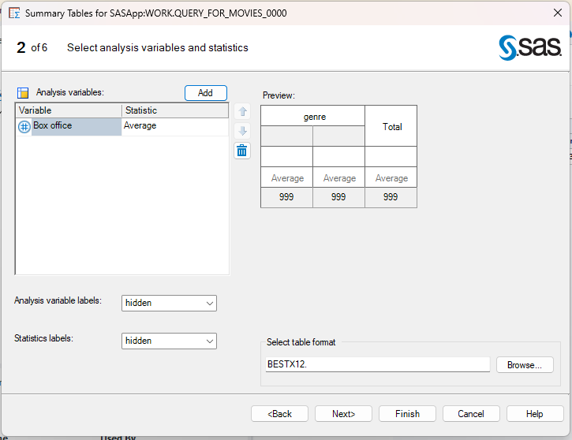
Hypothesis 4: Steps

Slide 38
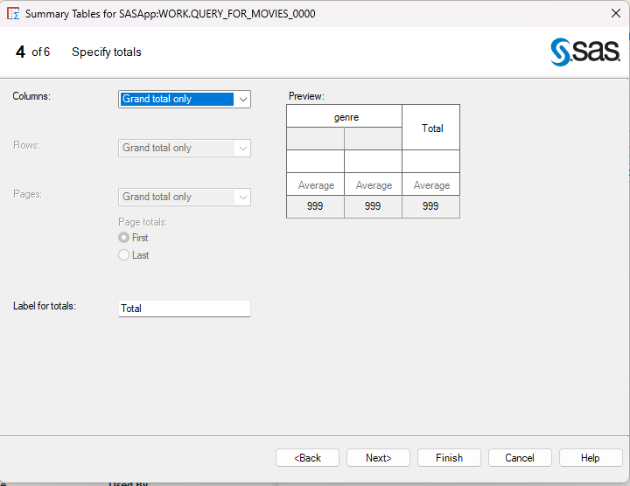
Hypothesis 4: Steps

Slide 39
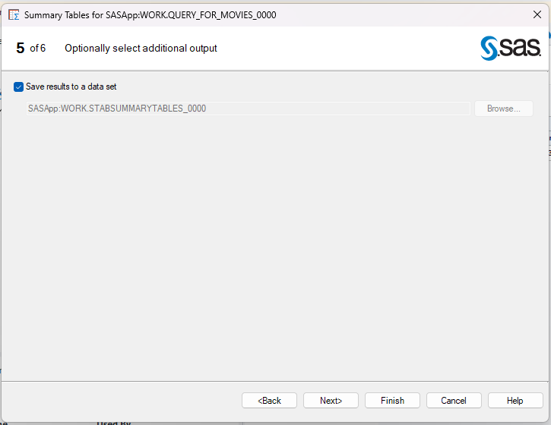
Hypothesis 4: Steps

Slide 40
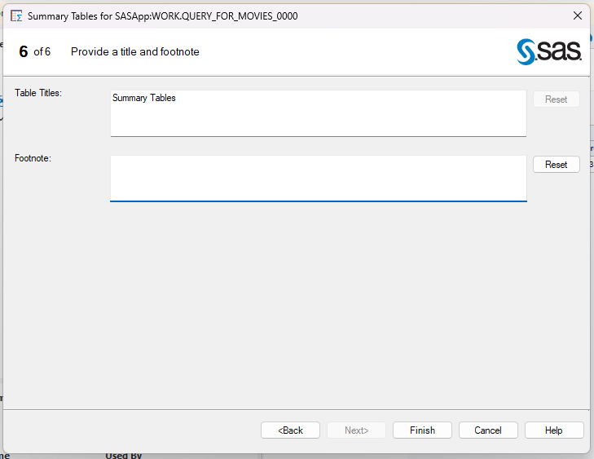
Hypothesis 4: Steps

Slide 41
Hypothesis 5
I assume that the USA, Canada, the UK, and France produce more restricted-rated movies compared to other countries.
Tasks used: One-Way Frequencies

Slide 42
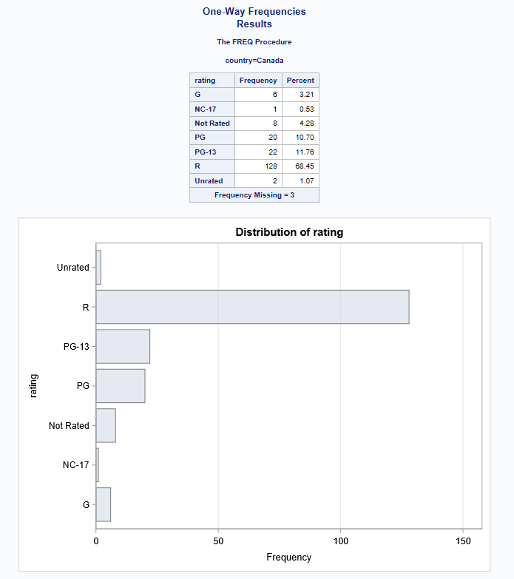
Hypothesis 4: One-Way Frequencies

Slide 43
Hypothesis 4: One-Way Frequencies

Slide 44
Hypothesis 4: One-Way Frequencies

Slide 45
Hypothesis 4: One-Way Frequencies

Slide 46
Summary
The analysis shows varied results across the hypotheses. Historical and musical genres are most liked, contrary to the assumption about action. Comedy is predominantly G-rated only in Italy. While the USA and UK have high-scoring movies, other countries like Germany and Brazil also contribute significantly. Sci-fi, family, comedy, and crime genres surpass action in box office revenue. Finally, the USA, Canada, the UK, and France are indeed leading in producing restricted-rated movies. Together, these findings highlight the diversity in audience preferences, genre success, and international film production impacts.

